Slide 1
A Hybrid Model Approach for Predicting Jet Engine Degradation Using Advanced Machine Learning Techniques
Practicum Presentation – Sandia National Labs
Sophia Oku, graduate student

Slide 2
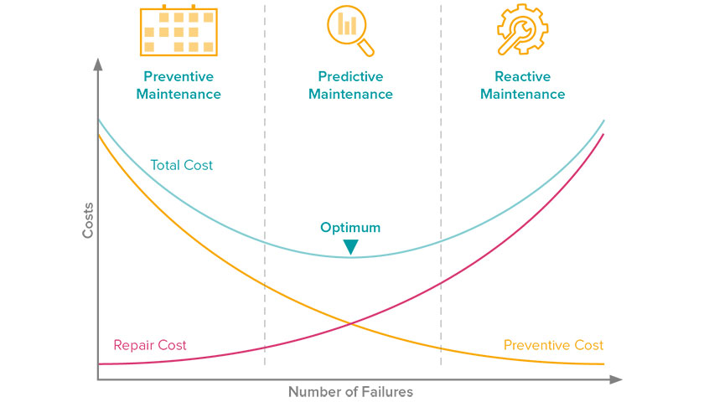
Introduction : Predicting Jet Engine Degradation
Aircraft jet engines are complex systems with multiple rotating components that degrade over time.
Early and accurate of performance degradation is critical for safety, reliability and cost-efficiency.
Traditional preventive maintenance approaches rely on scheduled inspections, often inefficient.
This presentation explores a hybrid machine learning approach to predict jet engine degradation based on sensor data from NASA's CMAPSS database.
Chart from SenseMore
Notes:
Chart link: https://sensemore.io/preventive-vs-predictive-maintenance/

Slide 3
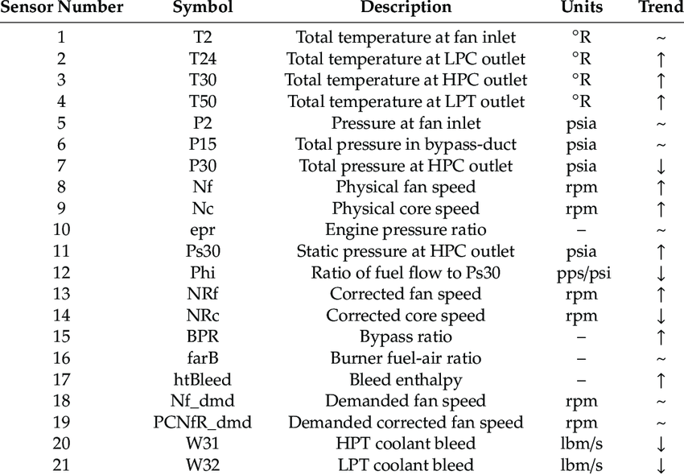
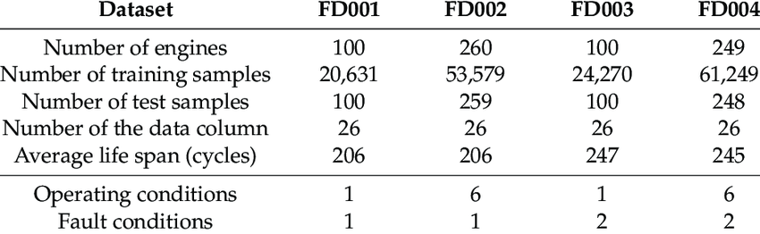
NASA C-MPASS Dataset Description
Source : NASA C-MPASS repository
Data Description:
Simulated dataset for dual-spool, high bypass turbofan jet engine degradation with process noise.
Dataset Features:
Engine unit number
Time (cycles)
Operation settings
21 Sensor Outputs
Selected Dataset Structure:
FD001: Single fault mode, single operating condition.
FD003: Two fault modes, single operating condition.
Hybrid Model Objectives:
Diagnostics (Classification): Identify healthy vs. degraded engines.
Prognostics (Prediction): Estimate Remaining Useful Life (RUL).
Hong et al. (2020)
Notes:
prognostics data challenge at the PHM’08 conference.
Hong, C. W., Lee, C., Lee, K., Ko, M., Kim, D. E., & Hur, K. (2020). Remaining Useful Life Prognosis for Turbofan Engine Using Explainable Deep Neural Networks with Dimensionality Reduction. Sensors, 20(22), 6626. https://doi.org/10.3390/s20226626

Slide 4
Literature Review: RUL Prediction Models
Li et al. (2021) – FD001
Support Vector Regression (SVR)
Long Short-Term Memory (LSTM)
PCA-LSTM (Principal Component Analysis + LSTM)
Performance:
RMSE = 19.43
Hong et al. (2020) – FD001
One - Dimensional Convolutional Neural Network (1D CNN)
Long Short-Term Memory (LSTM)
Bidirectional-LSTM (bi-LSTM)
Deep-stacked convolutional Bi-LSTM network
Performance:
RMSE = 10.41
Khumprom et al. (2020) – FD002 & FD004
Artificial Neural Networks (ANN)
Deep Neural Networks (DNN)
Performance:
RMSE = 44.71 (FD002)
RMSE = 44.95 (FD004)

Slide 5
Problem Statement – Developing a Hybrid Model for Jet Engine Health and RUL Prediction
Extensive literature review shows that advanced neural network models can significantly improve model accuracy on the NASA C-MPASS. However, these methods suffer from the “black box” effect – results are difficult to interpret.
Objective:
Develop a simplified hybrid model capable of providing both:
Classification: Identify healthy engines from non healthy engines based on a set threshold.
Regression: predict the Remaining Useful Life (RUL) for jet engines.
Hypothesis:
RUL predictions can be improved through a sequential hybrid model with an acceptable accuracy.
Notes:
Bias tradeoff

Slide 6
Model flowchart
Train Model – Initialize parameters – Validate Model
C-MAPSS Dataset
Linear regression
SVR
Decision Tree
CNN
LSTM
Test Model
Data Exploration
Labeling, Assumptions and Trends
Hybrid Model
Base Model
RUL and Classification
Data Preprocessing
Normalization, Scaling
Logistic regression
Random Forest
Boosting
CNN
LSTM
Evaluation
Feature Selection
Correlation Analysis, Trends , PCA

Slide 7
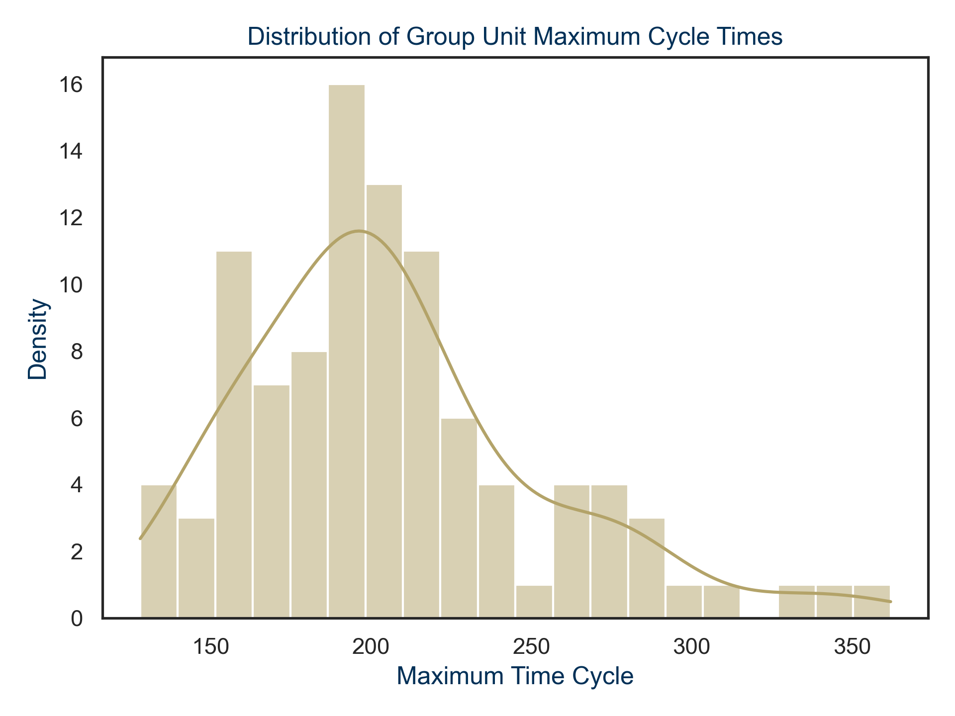
Exploratory Data Analysis
The earliest engine failure occurred at 128 cycles.
The longest-lasting engine failed after 362 cycles.
On average most engine failures occurred between 199 and 206 cycles.
Based on the correlation plot sensors 1, 5, 10 , 16 , 18 and 19 show no significant relationship throughout the cycle.
This was reconfirmed by the distribution of the sensor values from the descriptive statistics.
Initial Assumption
The first assumption is that the RUL changes linearly over time while keeping other factors constant e.g. (sudden changes and degradation, manufacturing defect)

Slide 8
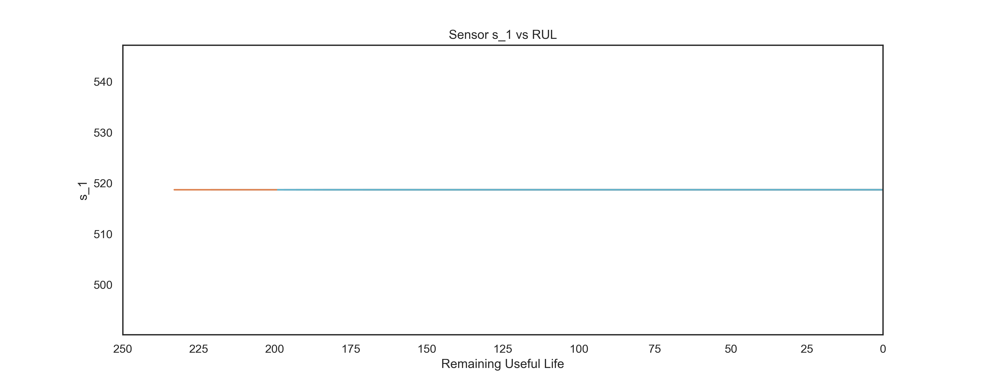
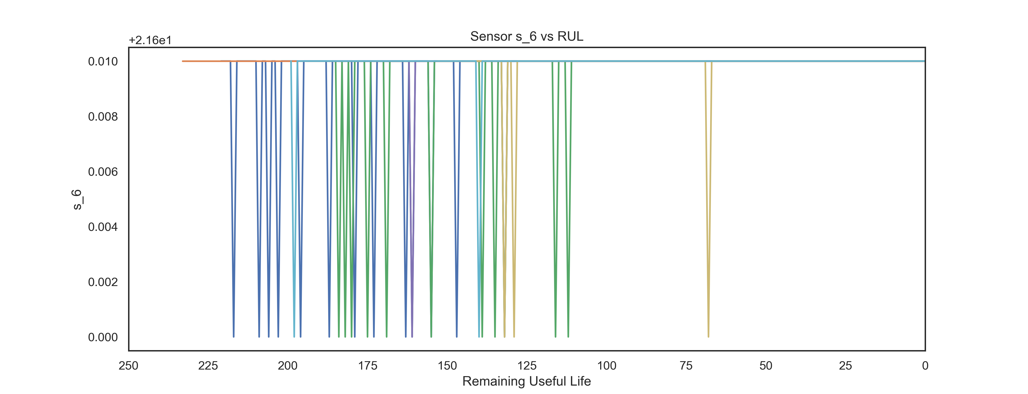
Exploratory Data Analysis Cont’d
Some sensors (e.g., S_1, S_5, S_10) showed a flat constant across all units suggesting that the sensors may not be contributing any meaningful life to the RUL prediction.
Few sensors (e.g., S_11, S_13, S_15) showed increasing trend in RUL as engine approached end of life.
Other sensors (e.g., S_12, S_20) showed a decreasing trend as RUL decreased.
S_6 exhibited sharp spikes suggesting anomalies in the data.
In summary, the data collected shows a good relationship between various jet engine parts and RUL.
Notes:
1,5,10,16,18,19,6,

Slide 9
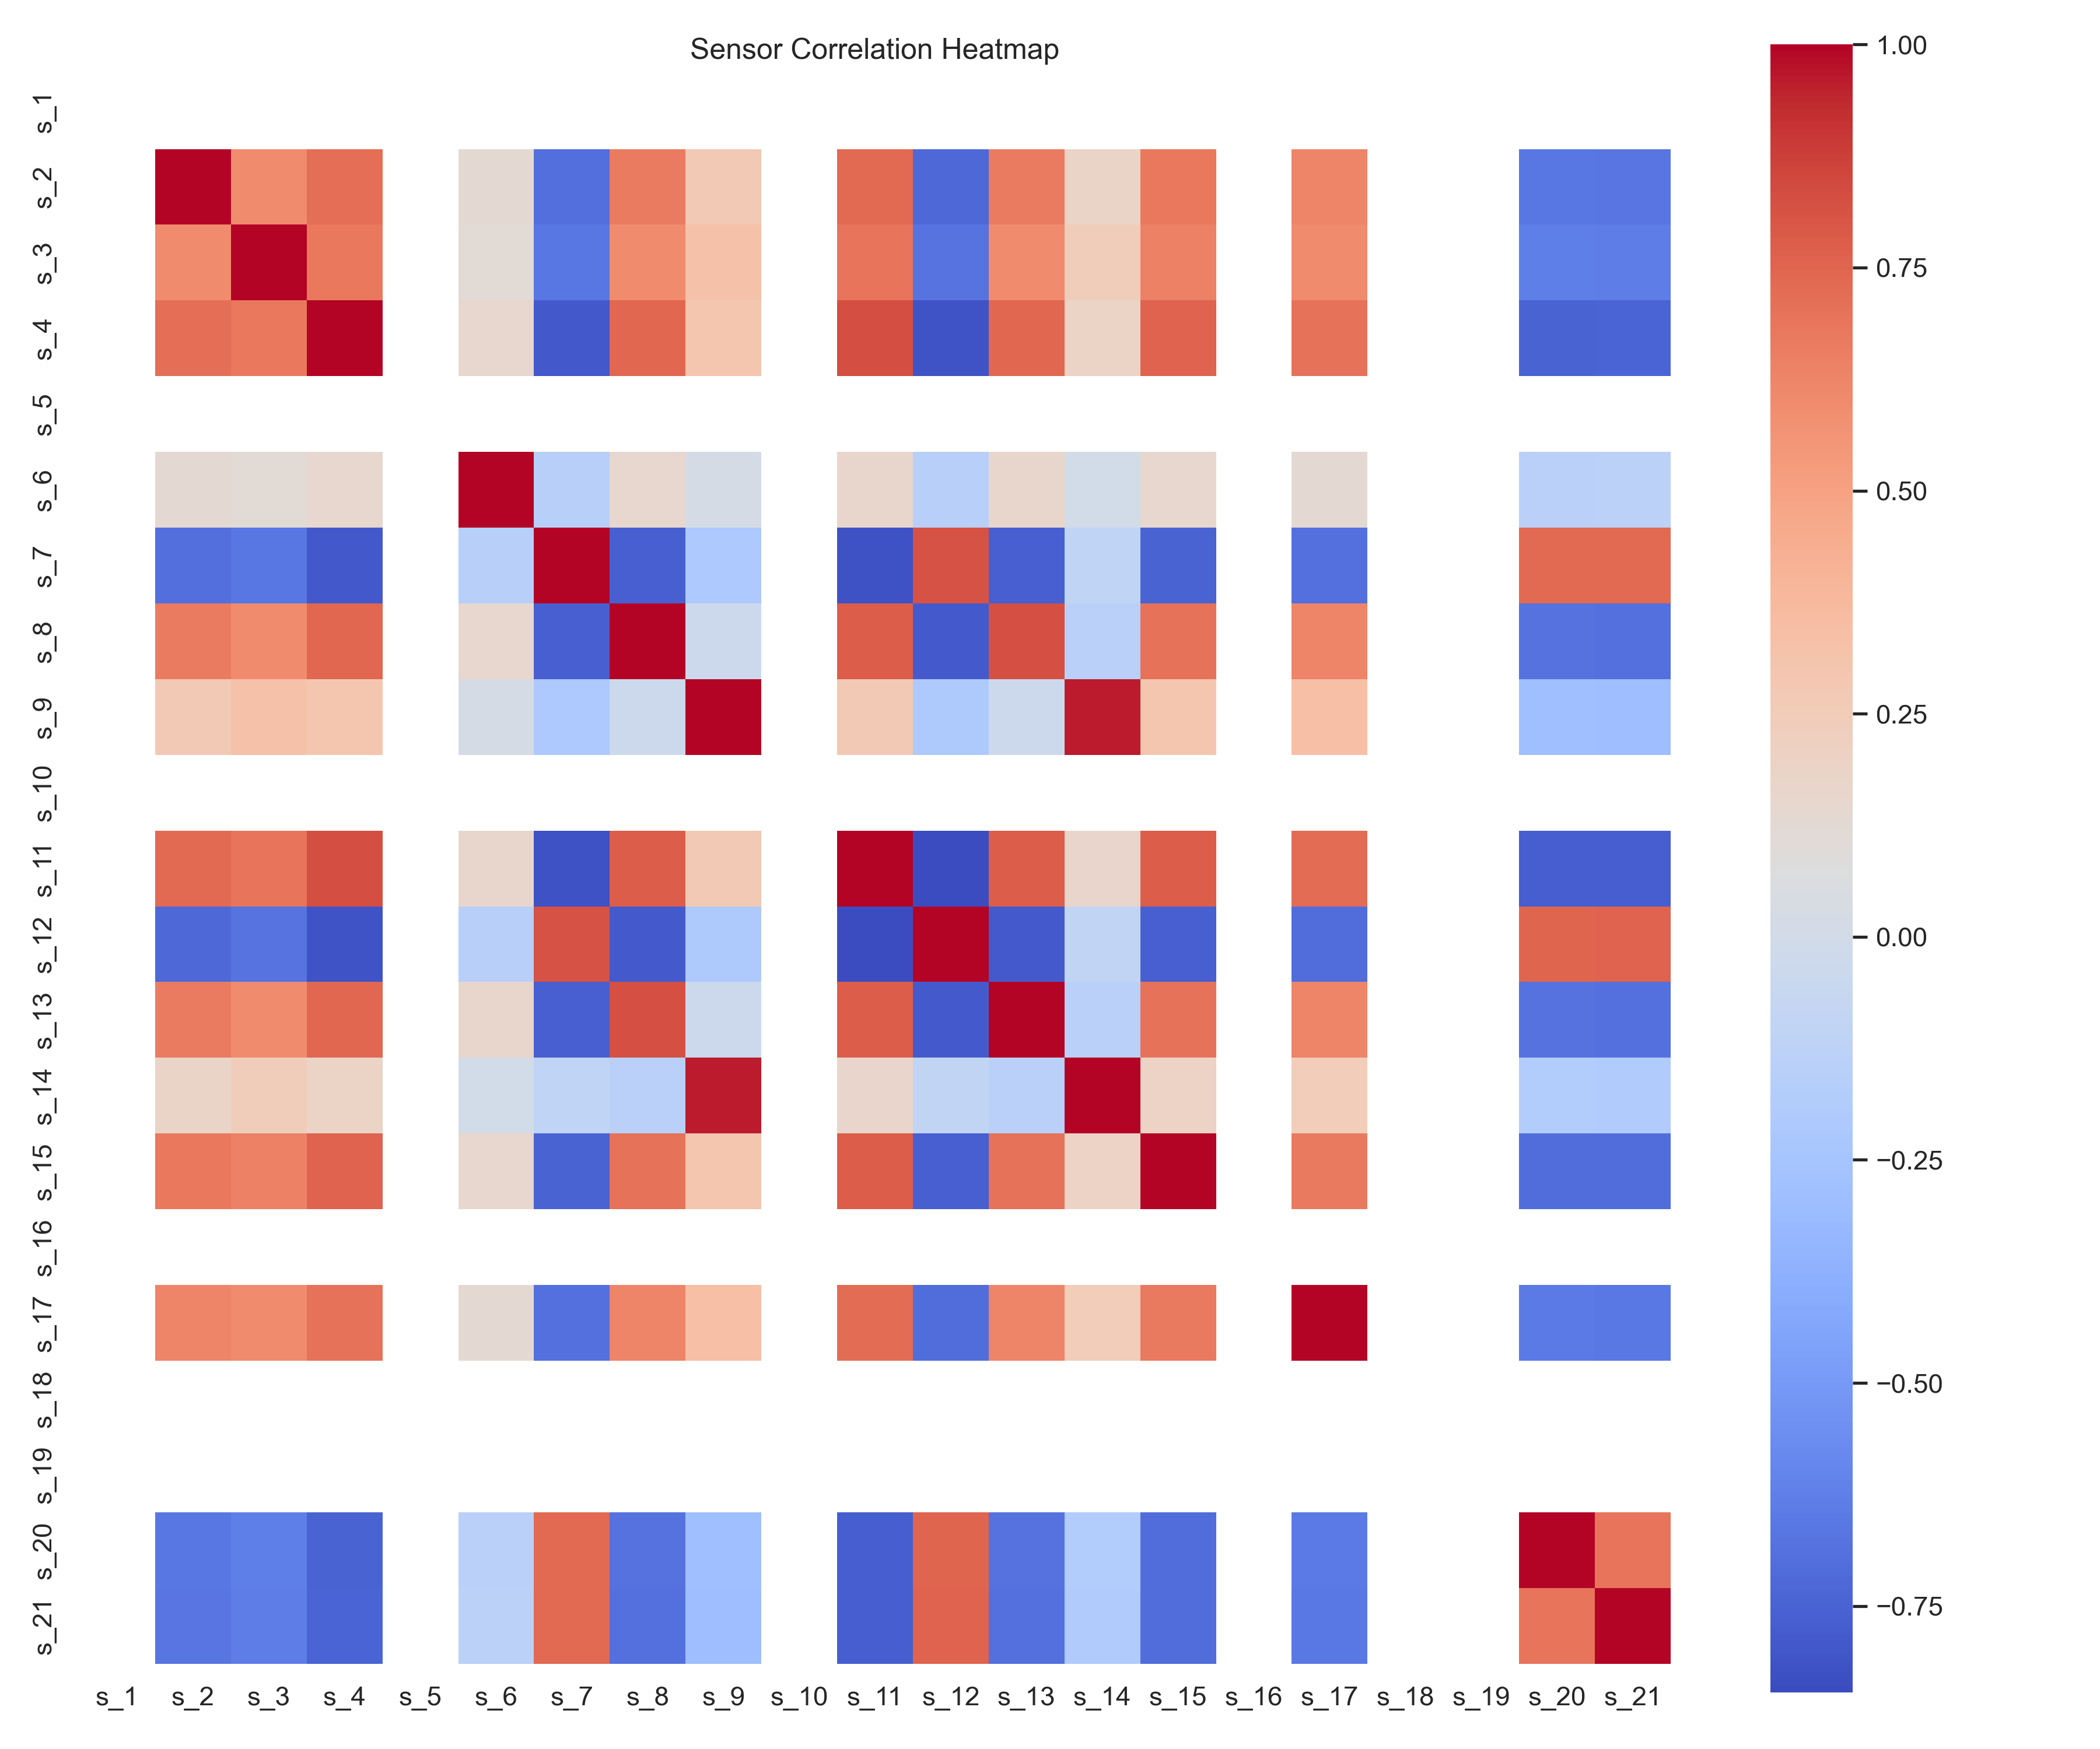
Exploratory Data Analysis Cont’d
Sensor 9 and 14 are highly correlated with a near perfect correlation rating of 0.963.
Based on the trends detected from the EDA, Sensors 1, 5, 6, 10, 14, 16,18, and 19 hold no valuable information in detecting RUL and were dropped.
12 sensors were retained for predicting RUL

Slide 10
Next Steps
Data Processing:
Normalization : Min-max normalization
Scaling
Feature selection
Baseline model training and evaluation
Linear regression
Logistic regression
Advanced model training and evaluation
Train models outlined in the workflow
Evaluate models:
Regression metrics: RMSE, MAE, or R².
Classification metrics: F-score, precision, recall, AUC, and AIC.
Parameter Tuning
Cross validation parameter tuning

Slide 11
Next Steps Cont’d
Hybrid Model Development:
Create a new feature from the best performing classification model.
Add new feature to the regression dataset as a new instance.
Train the best performing regression model on this new dataset
Model Comparison:
Compare performance metrics of the hybrid model with:
Non-hybrid models.
Results from other studies as an accuracy benchmark.
Compare accuracy metrics from the regression models to evaluate the added value of the hybrid model.
Validation and Testing:
Validate the model on the test set.
Final report and presentation

Slide 12
References
Hong, C. W., Lee, C., Lee, K., Ko, M., Kim, D. E., & Hur, K. (2020). Remaining Useful Life Prognosis for Turbofan Engine Using Explainable Deep Neural Networks with Dimensionality Reduction. Sensors, 20(22), 6626. https://doi.org/10.3390/s20226626
Khumprom, P., Grewell, D., & Yodo, N. (2020). Deep Neural Network feature selection Approaches for Data-Driven Prognostic Model of Aircraft engines. Aerospace, 7(9), 132. https://doi.org/10.3390/aerospace7090132
Li, H., Li, Y., Wang, Z., & Li, Z. (2021). Remaining useful life prediction of Aero-Engine based on PCA-LSTM. In 2021 7th International Conference on Condition Monitoring of Machinery in Non-Stationary Operations (pp. 63–66). https://doi.org/10.1109/cmmno53328.2021.9467643
Ramasso, E., & Saxena, A. (2014). Review and analysis of algorithmic approaches developed for prognostics on CMAPSS dataset. In Annual Conference of the PHM Society (1st ed., Vol. 6, Issue 1). https://doi.org/10.36001/phmconf.2014.v6i1.2512
Saxena, A., Goebel, K., Simon, D., & Eklund, N. (2008, October 1). Damage propagation modeling for aircraft engine run-to-failure simulation. In IEEE XPLORE. 2008 International Conference on Prognostics and Health Management, Denver, Colorado, United States of America. https://doi.org/10.1109/phm.2008.4711414
Shcherbakov, M., & Sai, C. (2022). A hybrid deep learning framework for intelligent predictive maintenance of cyber-physical systems. ACM Transactions on Cyber-Physical Systems, 6(2), 1–22. https://doi.org/10.1145/3486252

Slide 13
Data Processing

Slide 14
Base Model – Linear Regression

Slide 15
Base Model – Logistic Regression

Slide 16
Feature Selection

